Slide 1
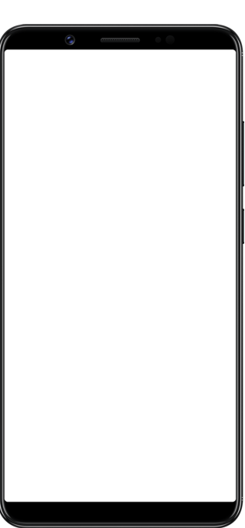
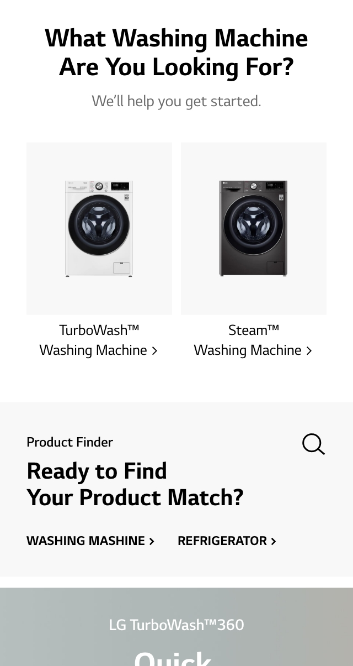
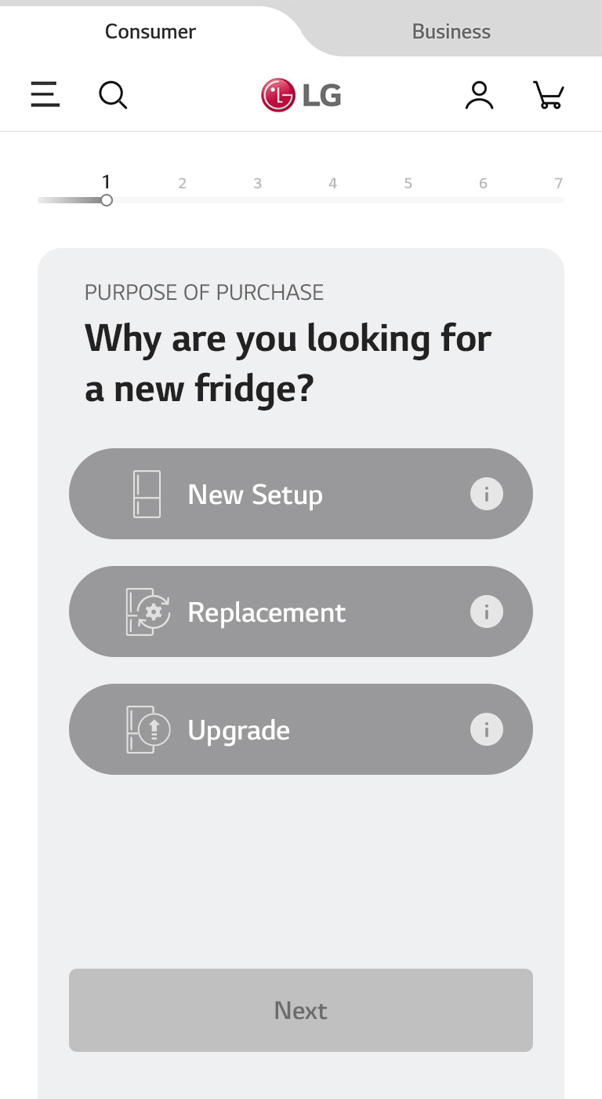
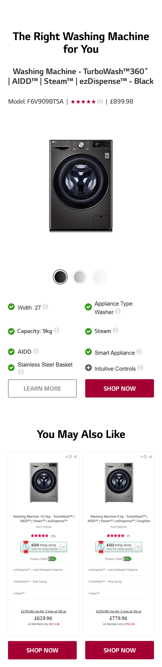
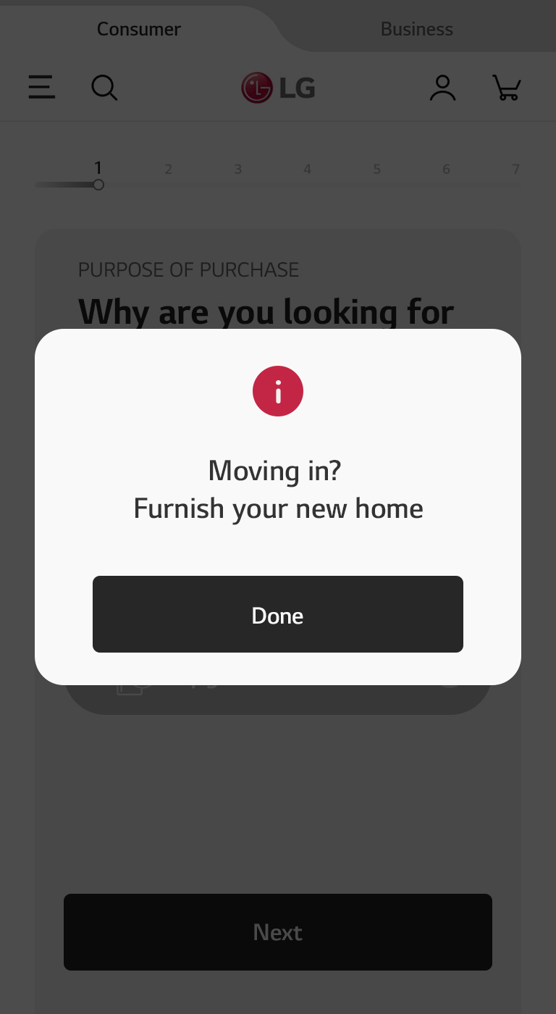
Quick Finder
1) Content Overview
다양한 플랫폼에 걸쳐 제품을 비교한 제품 고관여자에게 Category PLP 내 빠른 제품 선택을 돕는 Quick Finder 제공
Category PLP
Quick Finder
Result
1
PLP 내 Quick Finder 배너 클릭
2
7
새로운 페이지로 제품 Search 를 돕는 문항 제공
2
3
5
클릭 시
전체 문항 수 와 진행사항을 알려주는 네비게이션
3
5
4
픽토그램 답변지 구성으로 빠른 선택 유도
4
5
인포메이션 아이콘 클릭 시 디스클레이머 팝업 제공
1
6
Next / Back 버튼을 통해 질문 이동
8
7
Best 제품 추천
6
8
소비자가 선택했던 옵션들이 노출
9
앞에 선택했던
히스토리가 노출되게
해달라고 하네요 ㅠ
10
9
PDP 및 WTB 전환
10
Best Selling, New 제품 추천 연계 (Upselling)

Slide 2
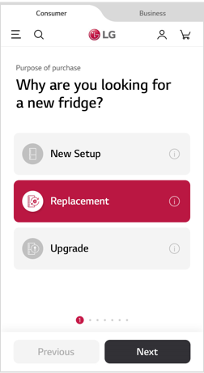
해당 시안 디자인으로 가되
옵션 쉐잎은 둥글게
냉장고 / 세탁기 전체 시안
잡아주세요
(디스클레이머 항목까지)

Slide 3
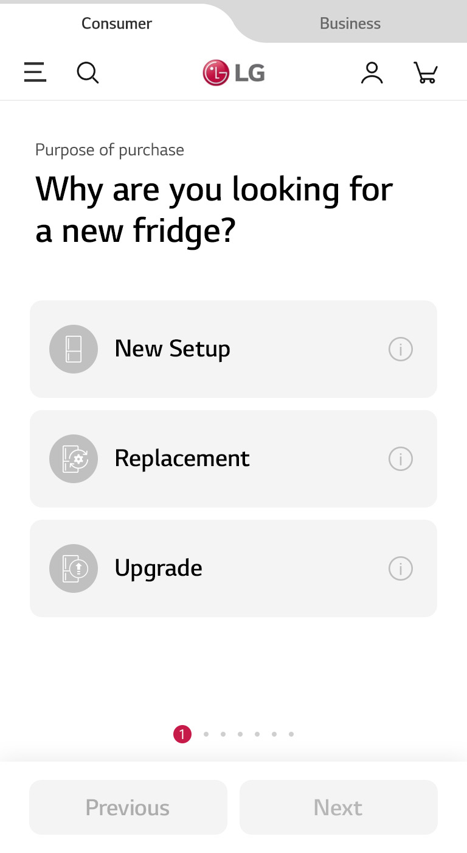
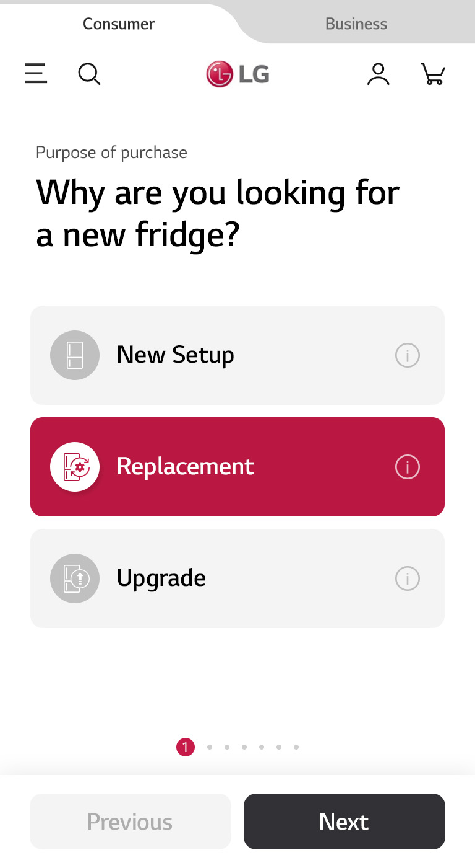
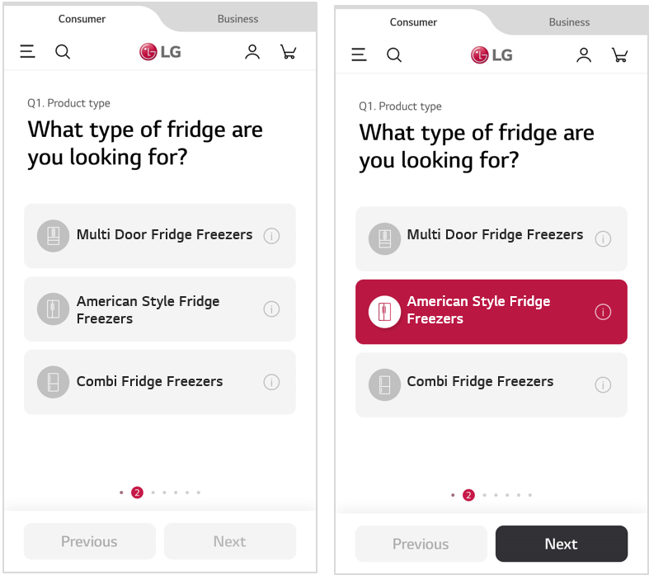
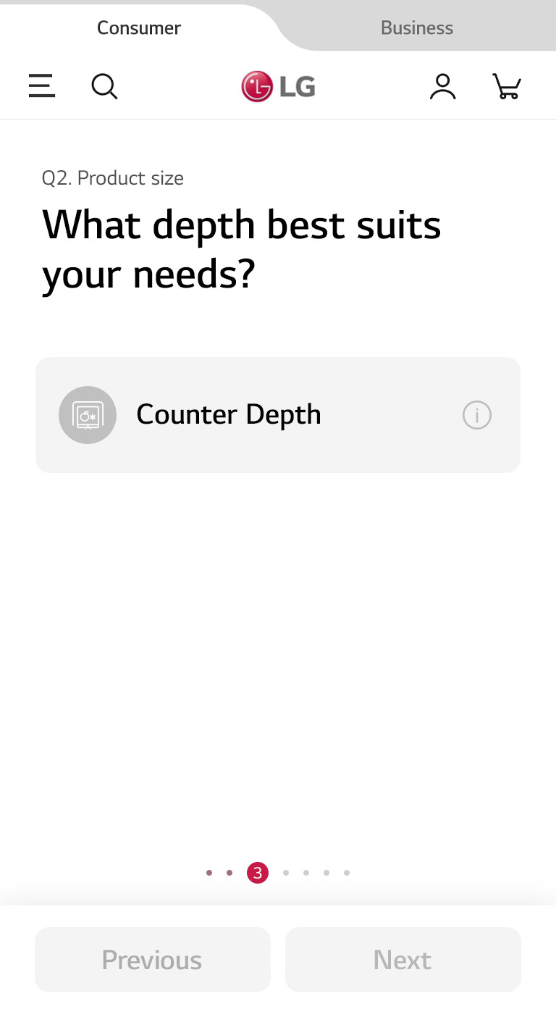
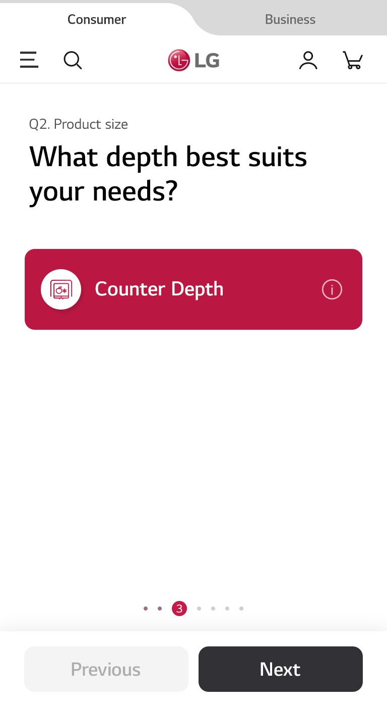
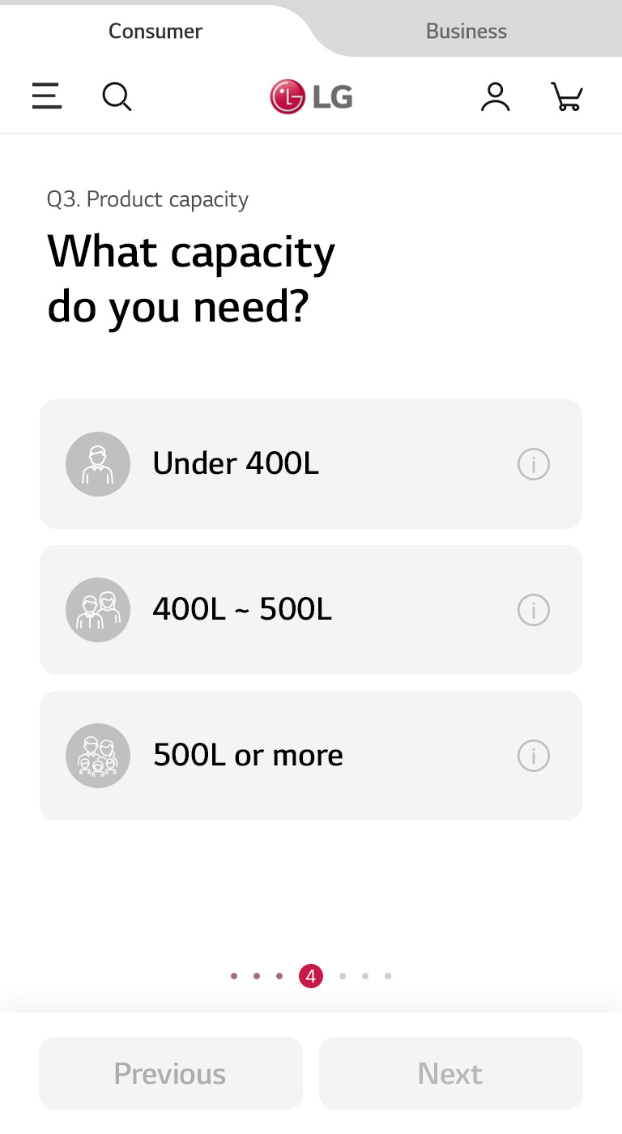

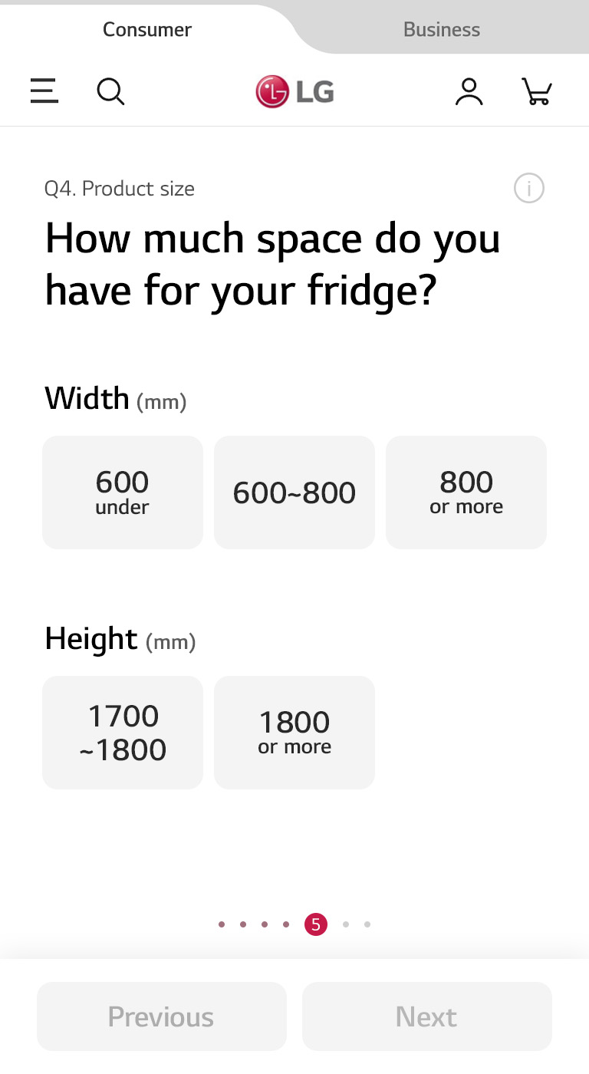
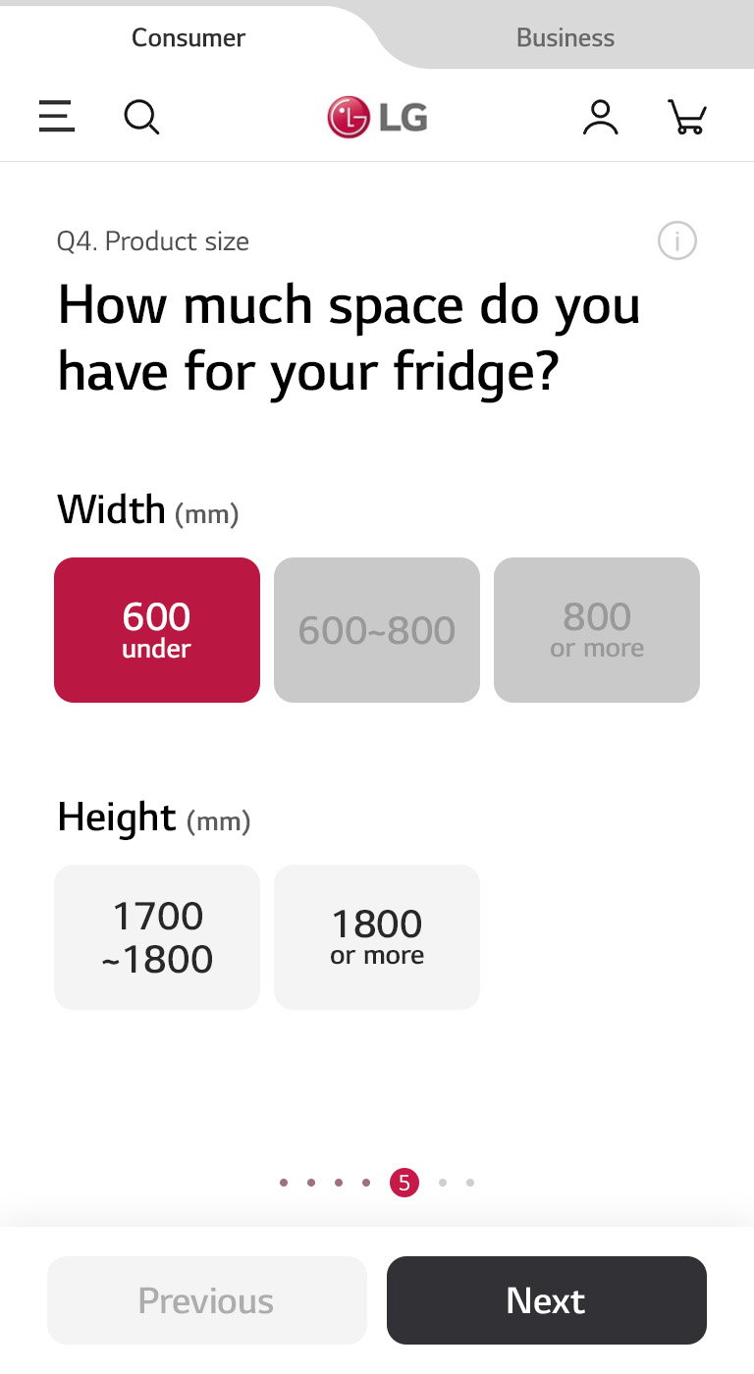
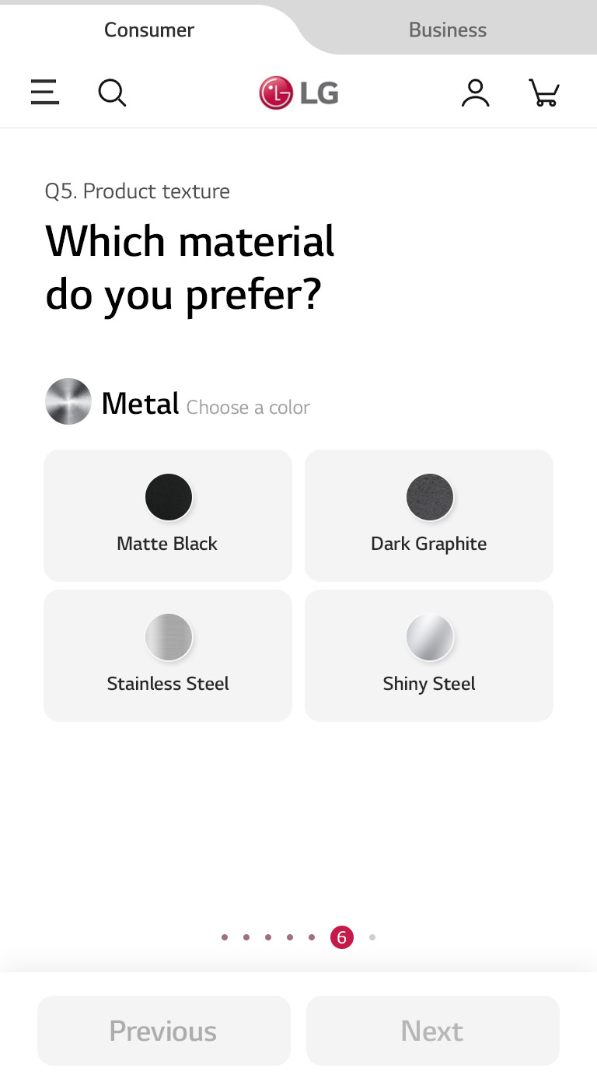
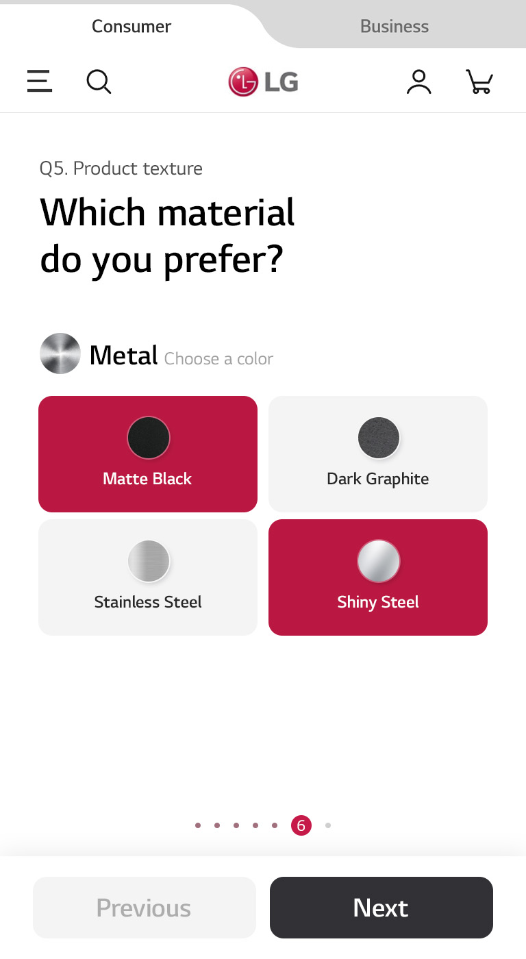
Quick Finder
2) Design
Option 2. 옵션 탭은 square shape을 활용, 옵션 클릭 시 LG 레드가 강조되어 보이는 안
* 시안은 현재 5번 질문까지 개발, 추후 피드백 반영하여 전체 시안 디벨롭 예정입니다.
Replacement를 선택하셨군요!
라는 식으로 질문 앞에 히스토리를 넣어달라고 합니다… (전체 문항에 적용)
아메리칸 스타일 프리지를 원하시는군요!
라는 식으로 질문 앞에 히스토리를 넣어달라고 합니다… (전체 문항에 적용)

Slide 4
[ Quick Finder 냉장고 시나리오_UK ]
Q0. Purpose of purchase
Why are you looking for a new fridge?
* 내부 데이터 확보를 위한 문항으로 Quick Finder 상에서는 옵션 별 시나리오는 동일
0-1.New Setup
Moving in?
Furnish your new home.
0-2. Replacement
Replace a defunct machine.
0-3. Upgrade
Switch to a more functional or better designed machine.
Q1. Product type
What type of fridge are you looking for?
* 해당 법인 제품 리스트에 따라 옵션 수정 필요
1-1. Multi Door Fridge Freezers
Underneath a twin-door setup that opens from the middle are freezer drawers. Offering ample space, they are ideal for bigger families.
1-2. American Style Fridge Freezers
Featuring double doors that open from the middle, these offer larger capacity than traditional single-hinged fridges.
1-3. Combi Fridge Freezers
This classic style is more compact, with the freezer at the bottom and handles aligned on one side.
Q2. Product capacity
What capacity do you need?
2-1. Under 500 L
Suitable for small families or groups.
2-2. 500 L or more
Suitable for large families or groups.
* 중간에 비어보이지 않게 500L를 기준으로 이상, 이하로 구분
Make sure you have accurate measurements of your space, in all three dimensions (width, height, and depth). And don’t let the details ruin it for you — doors will need space to open; the freezer will need some space (25-50 mm, depending on the size) for ventilation.
Q3. Product size
How much space do you have for your fridge?
* 중복 선택 가능
* 매칭되는 제품 사이즈 버튼만 활성화
Width
3-1. Under 700 mm
3-2.
700 mm or more
Height
3-1. 1700–1800 mm
3-2.
1800 mm or more
Q4. Product texture
Which material do you prefer?
* 중복 선택 가능
4-1. Metal
A bold and classic touch to any kitchen space.
4-2. Glass
A soft yet stylish finish that adds a unique touch to your interior.
4-1-1. Black
4-1-2. Stainless steel
4-1-3. Silver
4-2-1. White
* Matte black, Black Steel
* Textured STS, STS
* BS, MB, Platinum silver, Dark graphite
Q5. Purchasing intent
What’s more important to you (when buying a new fridge)?
제품 타입, 사이즈, 용량, 컬러에 해당하는 제품
가격순으로 추천
5-1. Reasonably priced
I'm looking for something affordable.
5-2. Convenience-oriented
I'm looking for a convenient product with the latest features.
I'm looking for a convenient product with the latest features.
Q6. Main function 1)
Which features are most important to you (when choosing a fridge)?
* 하단 USP 중 한 개라도 해당 되는 제품 추천
* 중복 선택 가능
* 제품 타입 별 기능 1) 항목으로 이동
6-1. Long-lasting Freshness
Keep food fresh and crisp whatever part of the fridge it’s stored in, with Linear Cooling, Door Cooling+ and more.
6-2. Ventilation
Pure N Fresh™ carbon air filtration reduces fridge odors. The option is applicable for Multi Door Fridge Freezers.
6-3. A or better
Energy Ratings
On less energy and less bills, maintain all your food in optimal condition with LG’s Inverter Linear Compressor
and Smart Inverter.
6-4. Easy to Use
Made for effortless usage so you no longer fuss with the details.
6-5. Smart/AI features
(ThinQ)
A smart assistance will ensure nothing falls through the crack.
6-6. Ice & Water dispenser
Enjoy fresh ice and water without opening the fridge.
Q6-4-1. Main function 2)
Which features do you need the most?
Q6-6-1. Main function 2)
Which features do you need the most?
6-4-1-1. InstaView™ Door-in-Door®
Easily see what’s inside without opening the fridge.
6-4-1-2. Door-in-Door®
Easily access parts of the fridge without having to open the fridge itself.
6-4-1-3. Extra Storage
Convertible components let you assemble and detach compartments according to your needs.
6-4-1-4. Contains other convenient features, i.e.
Contains misc. features for optimal convenience, i.e. a wine rack, folding shelf, reversible doors, and easy handles.
6-6-1-1. Plumbing /
Non Plumbing
Plumbed fridges can be a convenient source of water and ice if you can position your fridge near a water supply.
6-6-1-2. SpacePlus®
Ice System
A built-in icemaker designed to yield maximal door shelf space for other things.
6-6-1-3. UVnano™
A surefire way to get rid of bacteria, for those with high sanitation standards.
* Smart Storage system, Utility Box, Extra Space
* Wine rack, Folding shelf, EZ handle, Reversible door, Retractable Shelf, Zero Clearance, 2-Step Folding Shelf
선택한 옵션에 맞는 제품 추천

Slide 5
[ Quick Finder 세탁기 시나리오_공통 ]
Q0. Purpose of purchase
Why are you looking for a new washing machine?
* 내부 데이터 확보를 위한 문항으로 Quick Finder 상에서는 옵션 별 시나리오는 동일
0-1. New Setup
Moving in?
Furnish your new home.
0-2. Replacement
Replace a defunct machine.
0-3. Upgrade
Switch to a more functional or better designed machine.
Q1. Product type
What type of washing machine are you looking for?
1-1. Front Load Washing Machine
1-2. Washer and Dryer
Q2. Product capacity
What capacity do you need?
* 중복 선택 가능
* Washer and dryer는 건조기 용량도 함께 표기
* 해당 법인 제품 리스트에 따라 옵션 수정 필요
2-1. 8–10 kg (Dry 6–7 kg)
Takes more than 30 shirts in a single wash, making it suffice for a small family.
2-2. 10–12 kg (Dry 7–8 kg)
Takes more than 40 shirts in a single wash, which suffices for a large family.
Be sure to know precisely how much space you have for your new machine.
Even seemingly same-sized machines may differ in depth, so be on the lookout for finer details.
Q3. Product size
Which size best fits your space?
* 중복 선택 가능
* 매칭되는 제품 사이즈 버튼만 활성화
3-1. Width
Under 600 mm
3-2.
Depth
500mm or more
3-3.
Height
Under 970 mm
Q4. Product color
Which color do you prefer?
Find a color that naturally blends in with and enhances your interior.
* 중복 선택 가능
* 해당 법인 제품 리스트에 따라 옵션 수정 필요
4-1. White
4-2.Graphite
4-3/ Black Steel
Q5. Purchasing intent
What’s more important to you (in a washing machine)?
제품 타입, 용량, 컬러에 해당하는 제품
가격순으로 추천
5-1.Reasonably priced
I'm looking for something affordable.
5-2. Convenience-oriented
I'm looking for a convenient product with the latest features.
I'm looking for a convenient product with the latest features.
* 제품 타입 별 기능 1) 항목으로 이동
Q(A)6. FL, TL WM Main function 1)
Which features are most important to you
(in a washing machine)?
Q(B)6. WD Main function 1)
Which features are most important to you
(in a washing machine)?
* 중복 선택 가능
* 중복 선택 가능
(A) 6-1. Washing Performance
A machine that gets the job done well.
(A)6-2. Time-efficient
(TurboWash 360)
Saves you time while giving a thorough wash.
(A)6-3. Energy-efficient
(rated Class A)
Do good for the environment and your bills with LG machines.
(A) 6-4. Smart Assistance
Easily monitor and remotely control your machine with ThinQ.
(A) 6-5. Hygiene
(Steam™)
- Removes allergens to ensure sanitation.
(B) 6-1. Washing and Drying Performance
A machine that gets the job done well.
(B) 6-2. Time-efficient
(TurboWash 360)
- Saves you time while giving a thorough wash.
(B) 6-3. Energy-efficient
(rated Class A)
- Do good for the environment and your bills with LG machines.
(B) 6-4. Smart Assistance
- Easily monitor and remotely control your machine with ThinQ.
(B) 6-5. Hygiene
(Steam™)
- Removes allergens to ensure sanitation.
(A)6-1-1 Main function 2)
Which features do you need the most?
(A)6-4-1. Main function 2)
Which features do you need the most?
(B)6-1-1. Main function 2)
Which features do you need the most?
(B)6-3-1. Main function 2)
Which features do you need the most?
(A) 6-1-1-1 Powerful washing
(TurboWash 360, TurboWash™)
I need a machine that can power through dirt and stains.
(A)6-1-1-2. Gentle fabric care for minimal damage
(AIDD™)
I need a machine that won’t damage delicate clothes.
(A) 6-4-1-1. Automated allocation and disposal of detergent
(EzDispense™)
I need a machine that dispenses the right amount of detergent automatically.
(A) 6-4-1-2. Fabric-sensing minimizes damage
(AIDD™)
I need a machine that can sense fabric type and automatically select the most appropriate washing motion.
(A)6-4-1-3. Remote access and control
(ThinQ)
I need a machine I can keep an eye on remotely.
(B) 6-1-1-1
Powerful washing and drying
(TurboWash 360, TurboWash™)
I need a machine that can power through dirt and stains.
(B) 6-1-1-2
Gentle fabric care for minimal damage
(AIDD™,)
I need a machine that won’t damage delicate clothes.
(B) 6-3-1-1
Automated allocation and disposal of detergent
(EzDispense™)
I need a machine that dispenses the right amount of detergent automatically.
(B) 6-3-1-2
Fabric-sensing minimizes damage
(AIDD™)
I need a machine that can sense fabric type and automatically select the most appropriate washing motion.
(B) 6-3-1-3
Remote access and control
(ThinQ)
I need a machine I can keep an eye on remotely.
선택한 옵션에 맞는 제품 추천

